Slide 1






Order Genie
TEAM TESSERACT

Slide 2



Introducing
01
The use case was to develop an open-ended application of “Order Processing System”
Order Genie
Order Genie

Slide 3
02
Features
Authentication
3 Levels of product
Small Customers
Focus on both markets
Large Customers
Tracks of orders
Inventory Management
Order Genie

Slide 4


Customers
03
The order genie focus was to create space for small customers as well as large customers.
The small customers have small, concise and mixed requirements.
A large customer needs more catering from our company.
Order Genie

Slide 5

Backend
Backend consists of all the required components and RDBMS database. The backend is connected with the database in storing and retriving data.
Frontend
04
Frontend consists of HTML, CSS, JS without use of bootstrap. The simple flow shows the functionality to the most. The JS scripts are connected to the Json dataset.
Order Genie

Slide 6


Flow of webapp
Login/Authentication
05
The employee or customer [small or large group] logs in the webapp.
Customer [order management]
The small customer can see the products and get the order.
The large customer can approve or reject the quotes made by employees
Employee [order management]
The employee can create quotes based on the large customer requirements and provide special support for such customers.
Order Genie

Slide 7



09
Gallery Images
Here is our website in action and in its it full glory!
Order Genie

Slide 8
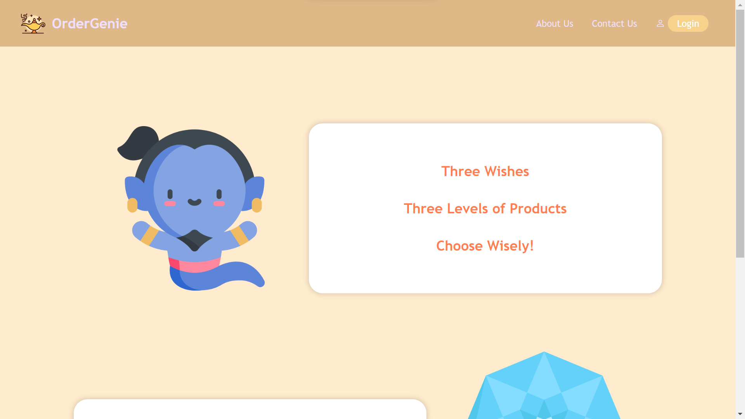

Slide 9
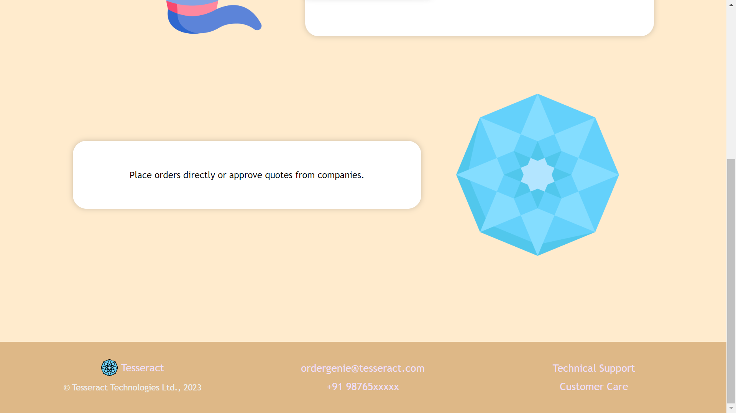

Slide 10
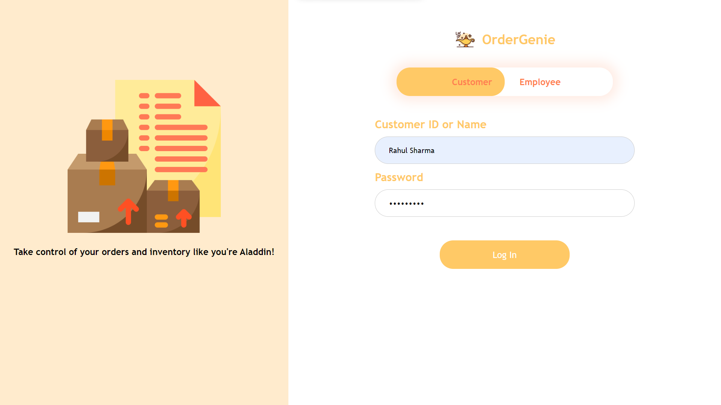

Slide 11
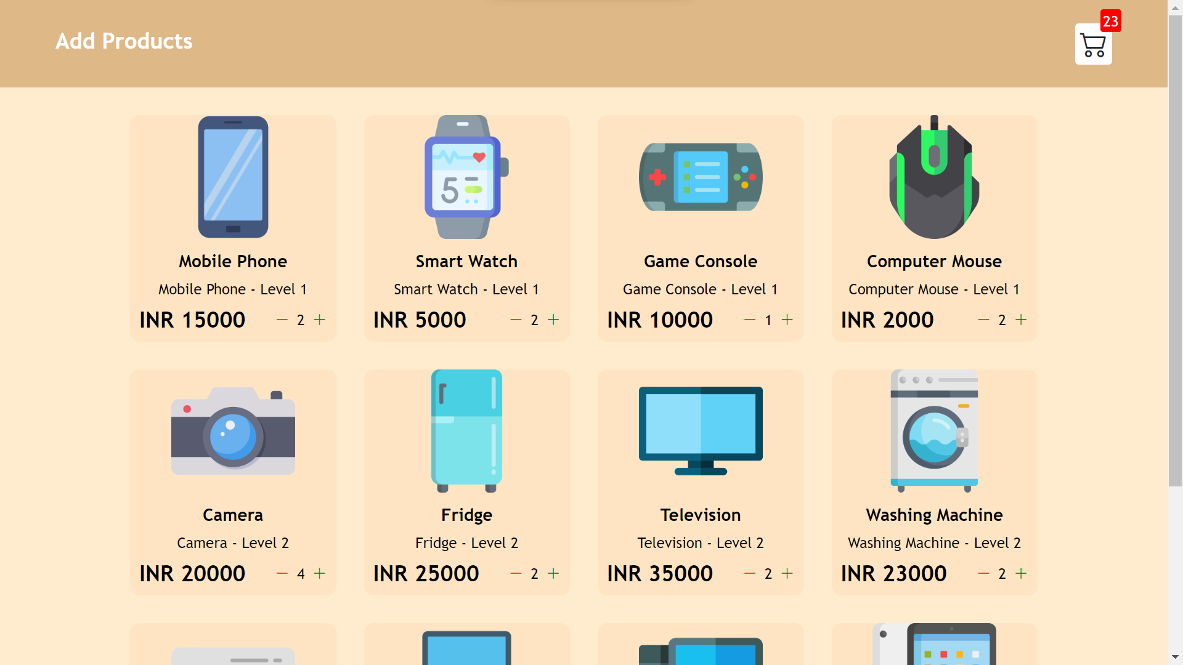

Slide 12
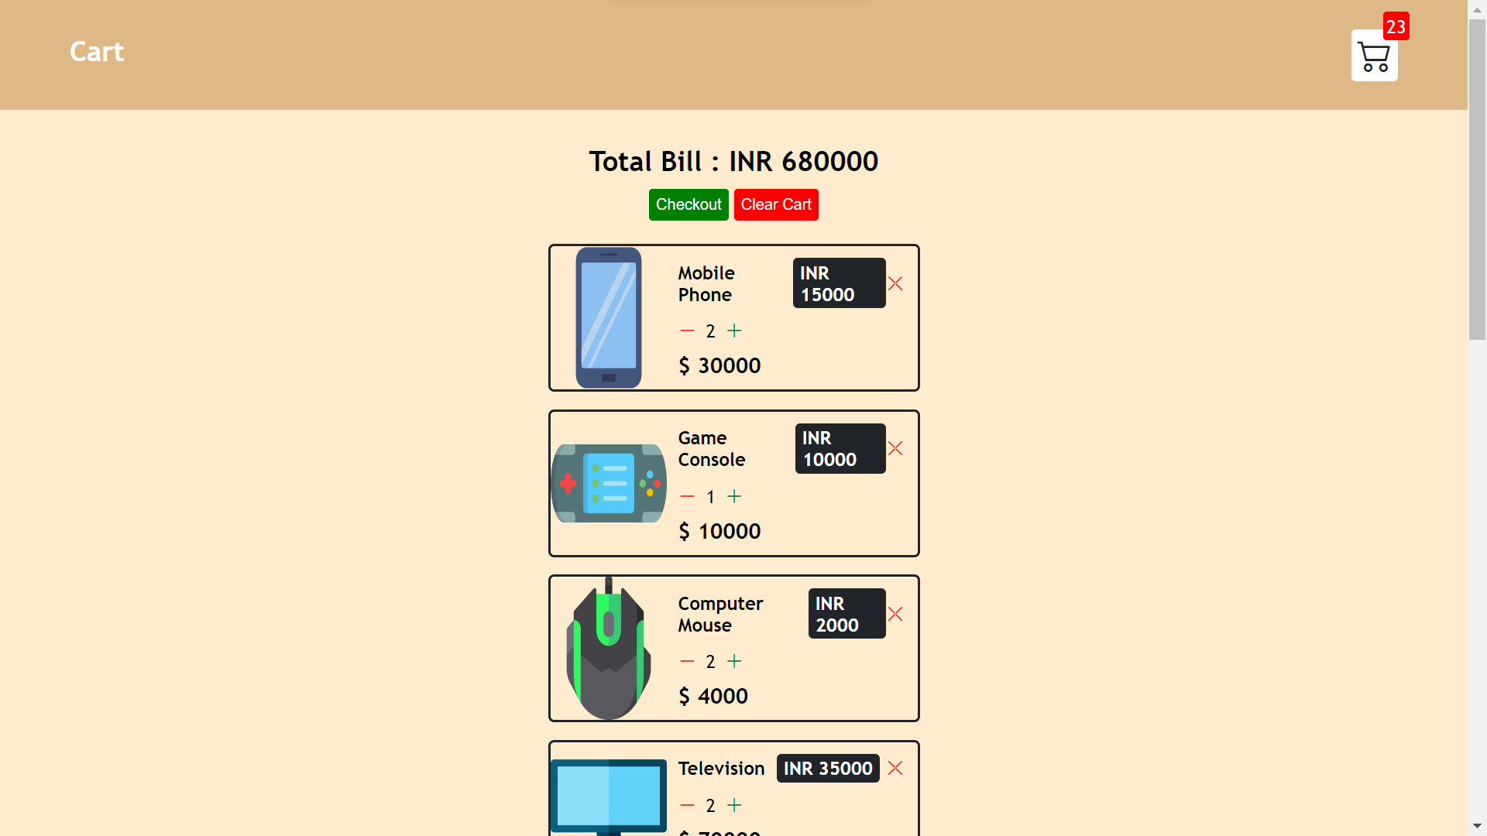

Slide 13
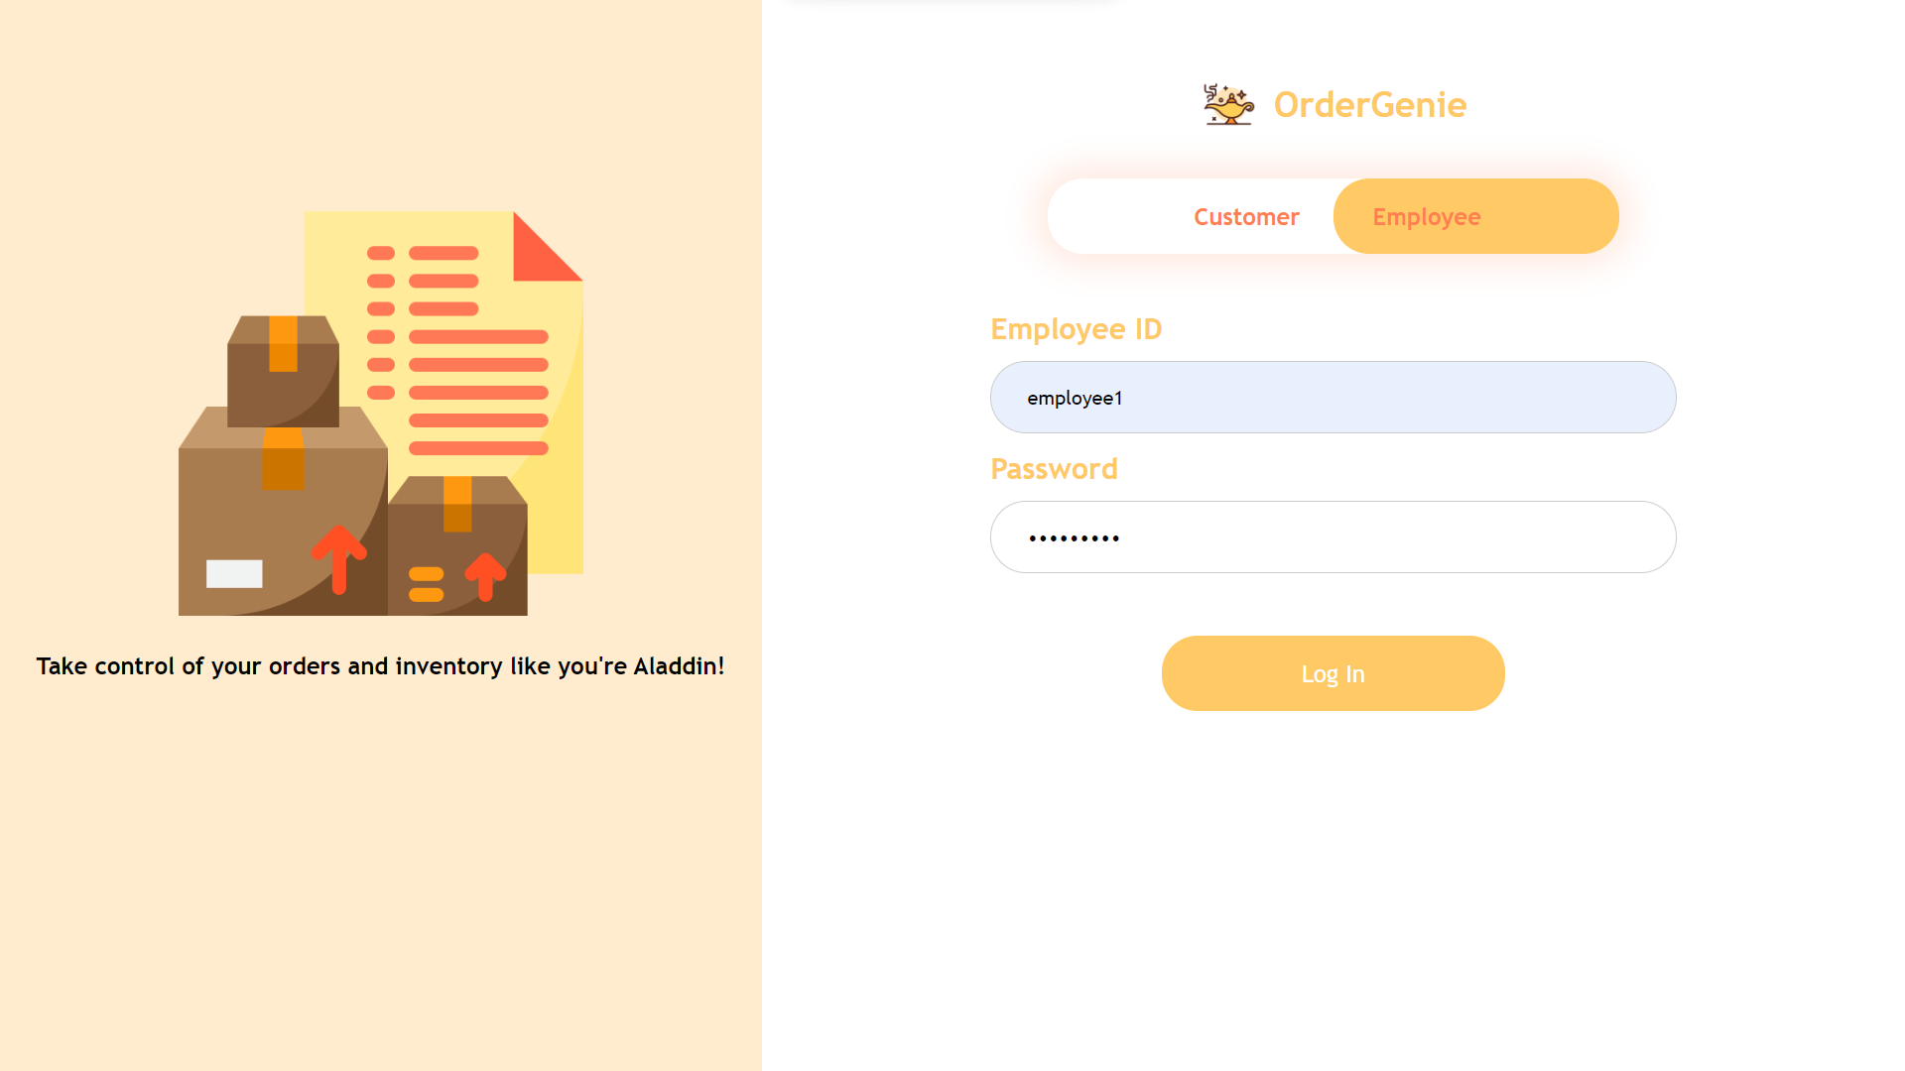

Slide 14
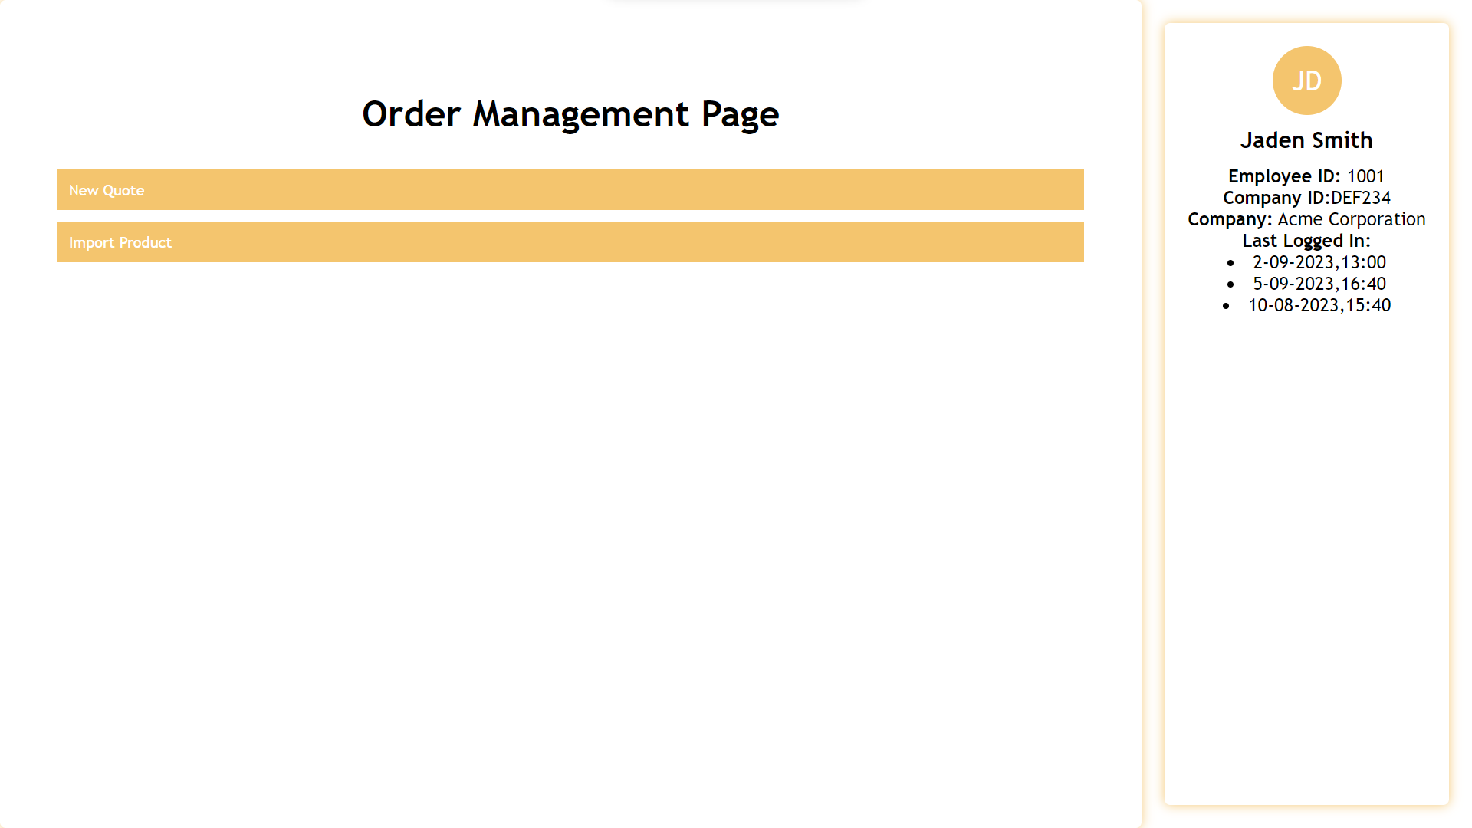

Slide 15
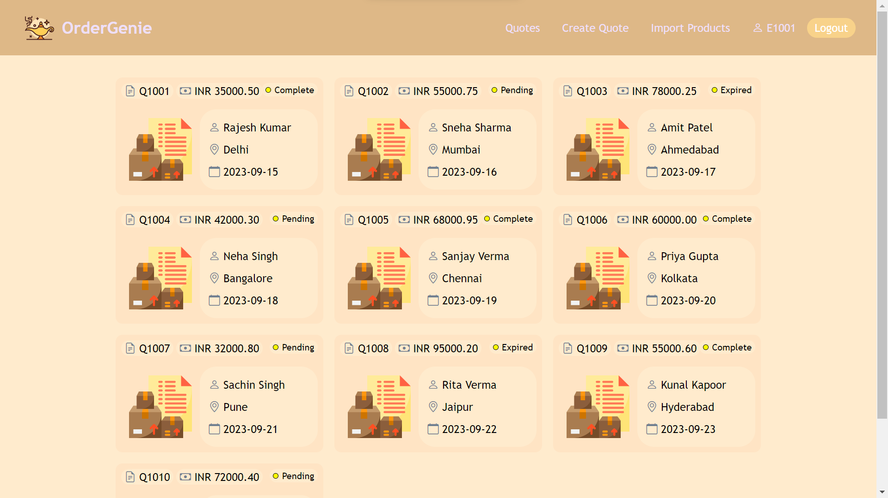

Slide 16
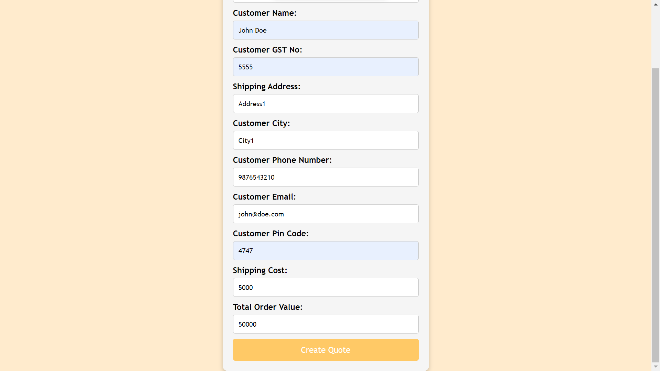

Slide 17


Thank You

